Slide 1
Practical aspects of
Spike Sorting
(supplementary materials)
Mike Sintsov
Head of Man-Machine Interfaces
at Motorica LLC

Slide 2
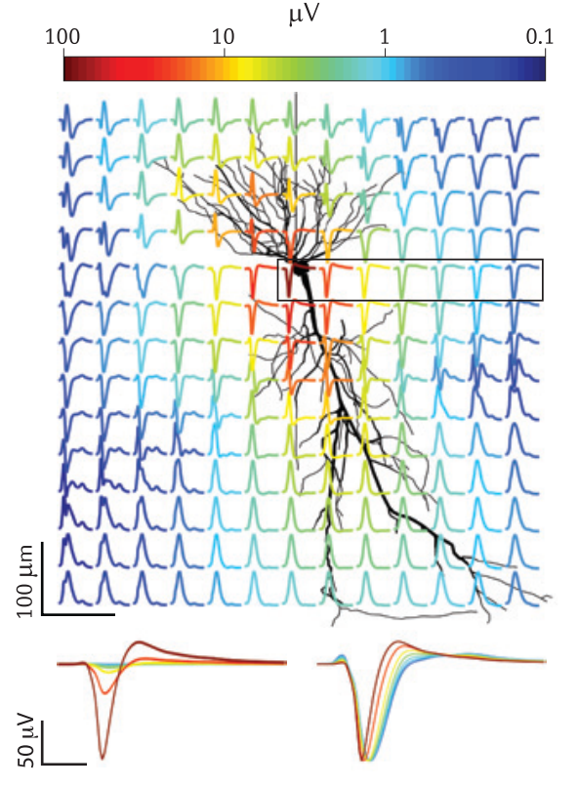
What is spike sorting
Spike sorting is data clustering and segmentation problem using recordings of extracellular action potentials in order to find robust markers of exact cell activity
10.1038/nrn3241

Slide 3
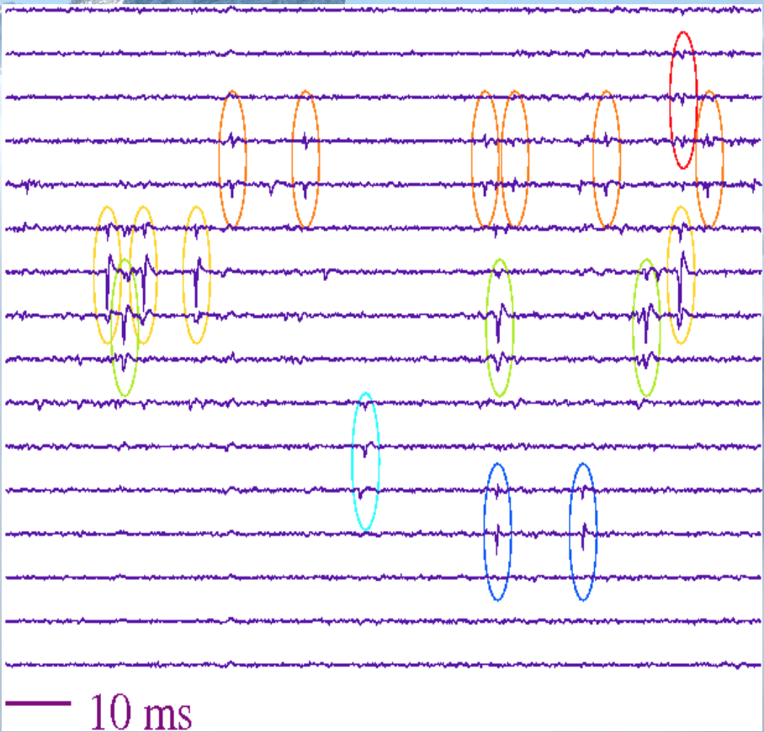
Segmentation and clustering

Slide 4
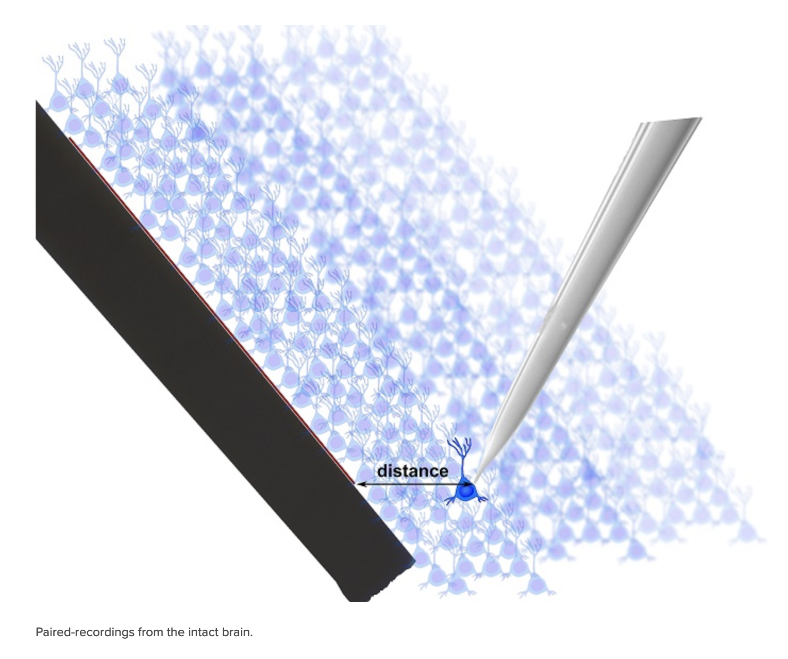

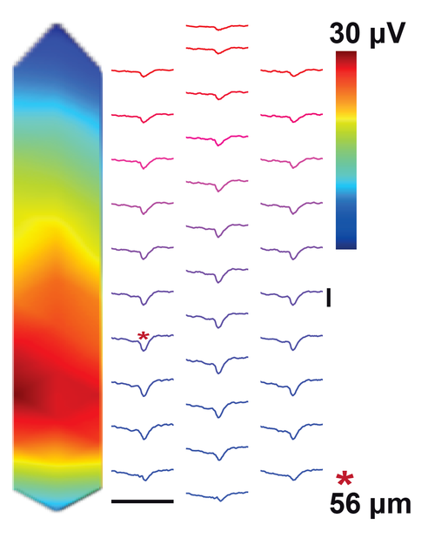
Dataset
http://www.kampff-lab.org/validating-electrodes
https://web.archive.org/web/20220130061955/http://www.kampff-lab.org/validating-electrodes

Slide 5
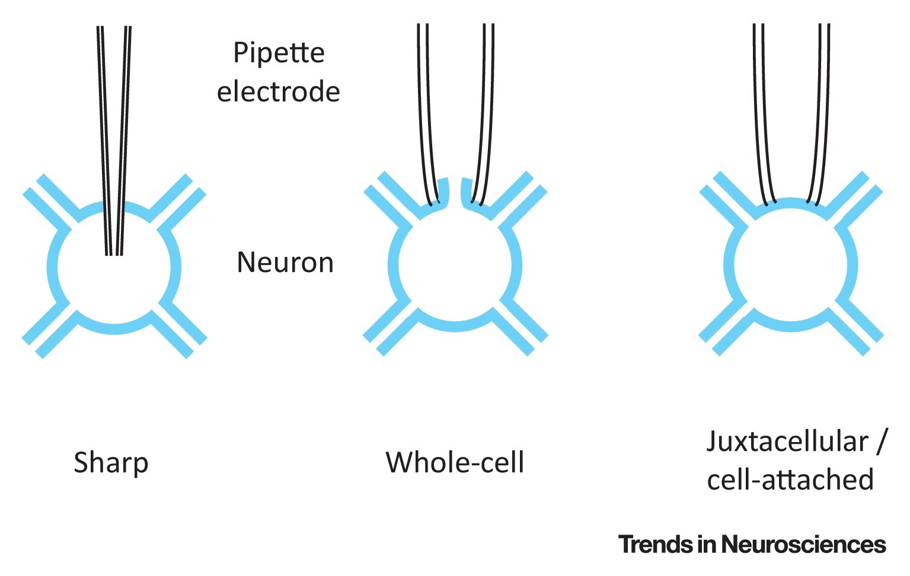
What are juxtacellular recordings?
Острый электрод
Целая клетка
Прилегающий патч

Slide 6
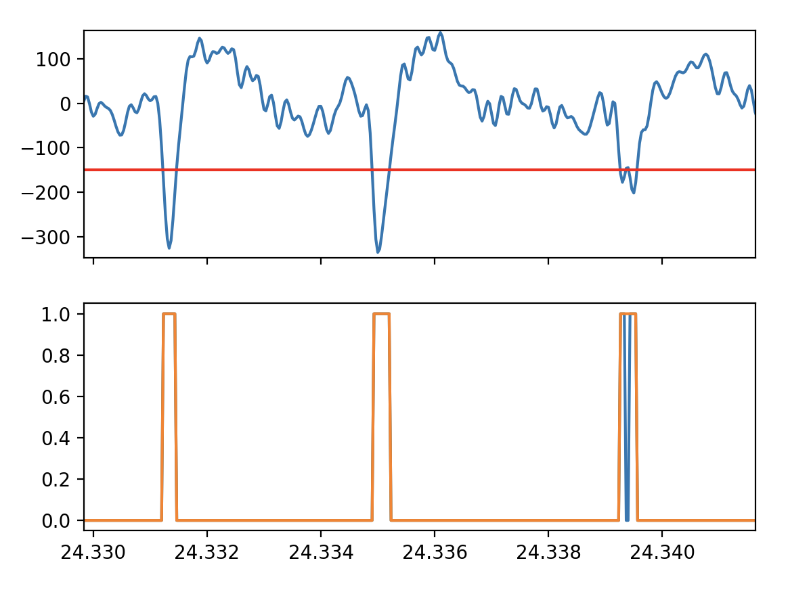
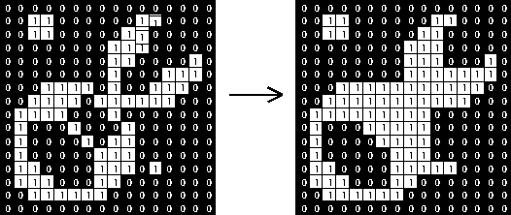
Binary closing

Slide 7
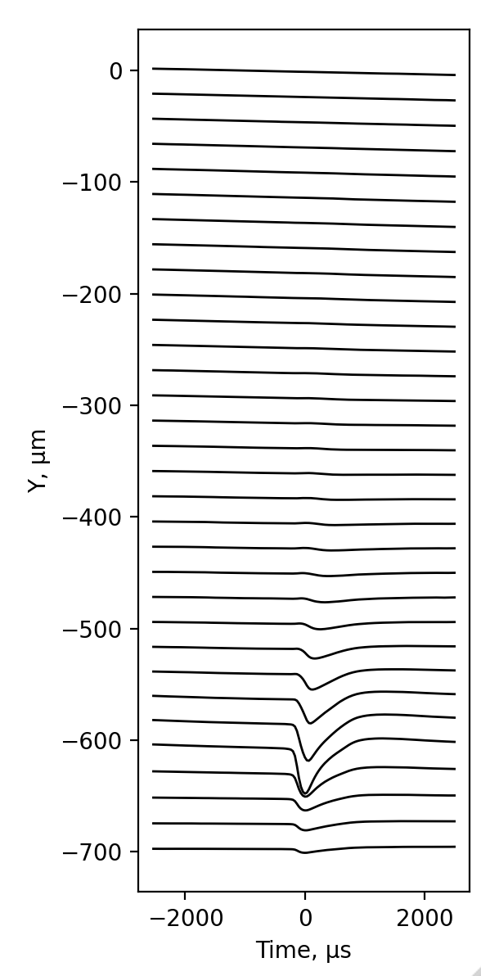
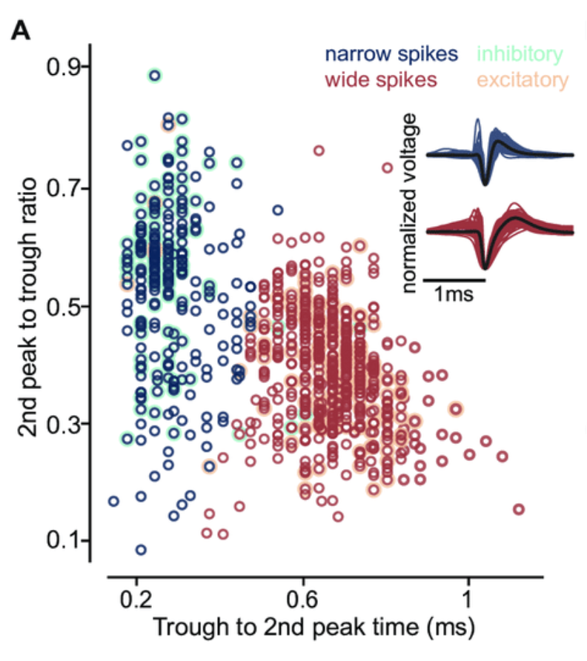
Putative excitatory and inhibitory neurons
Наблюдаемые возбуждающие и тормозящие нейроны
Source: 10.1101/2021.01.22.427789.

Slide 8
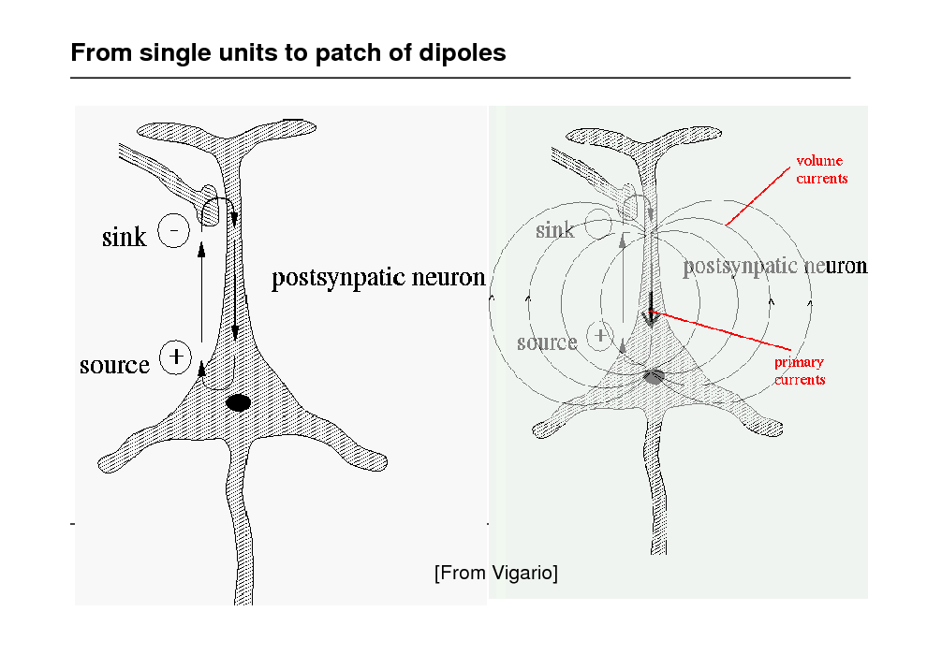
Current Source Density (CSD) analysis

Slide 9
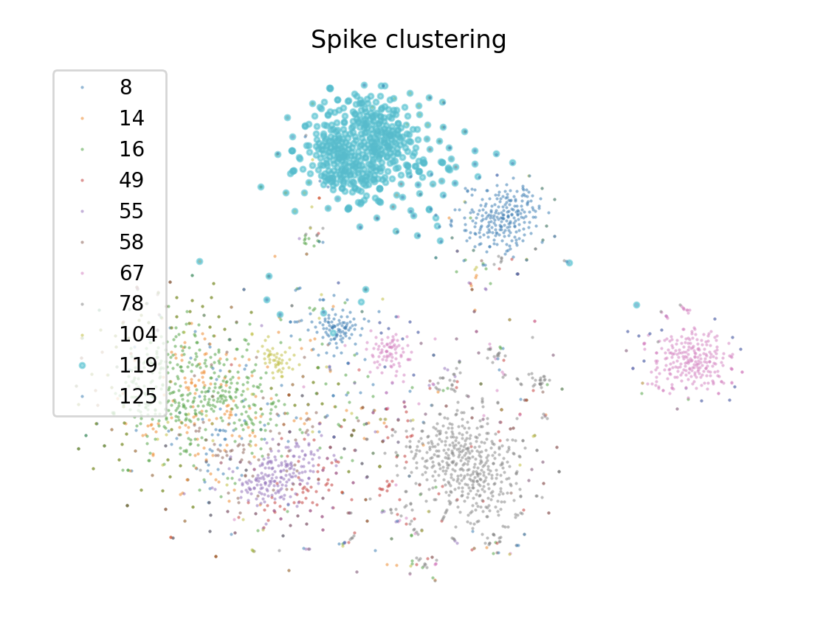
Spike clusters

Slide 10
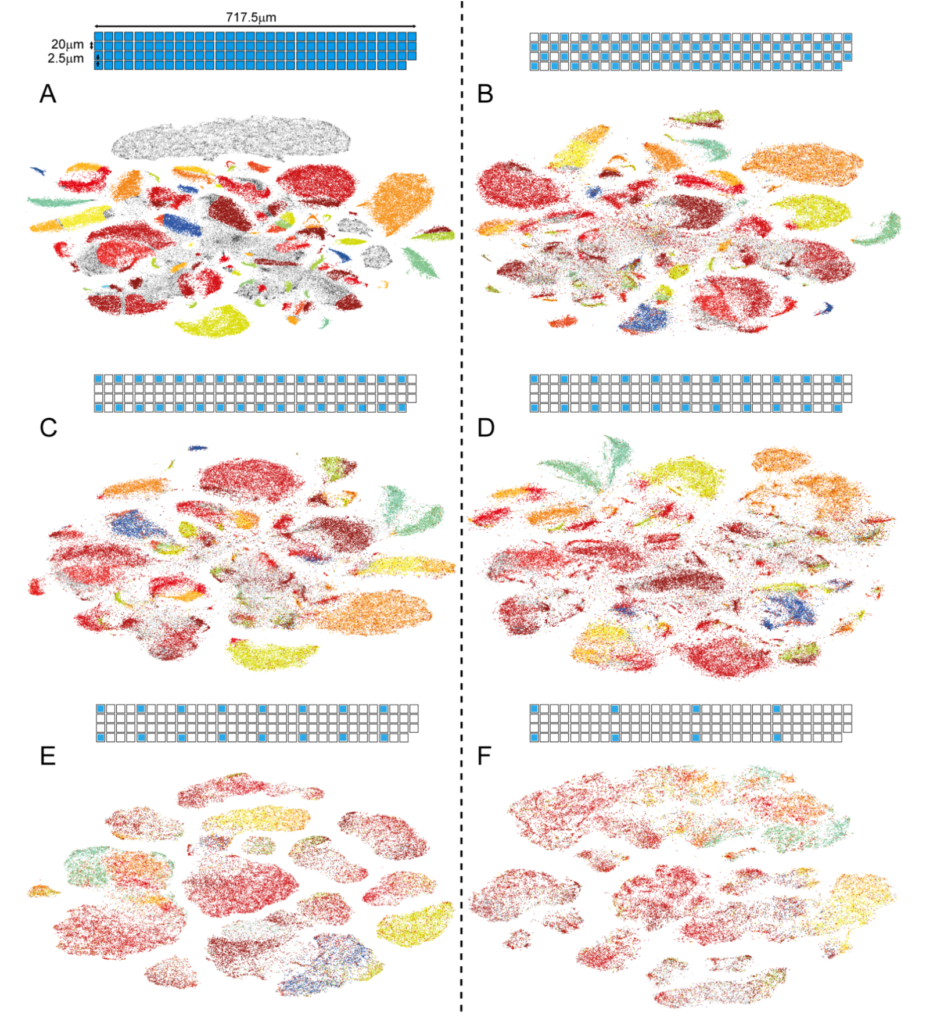
Probe density effects

Slide 11
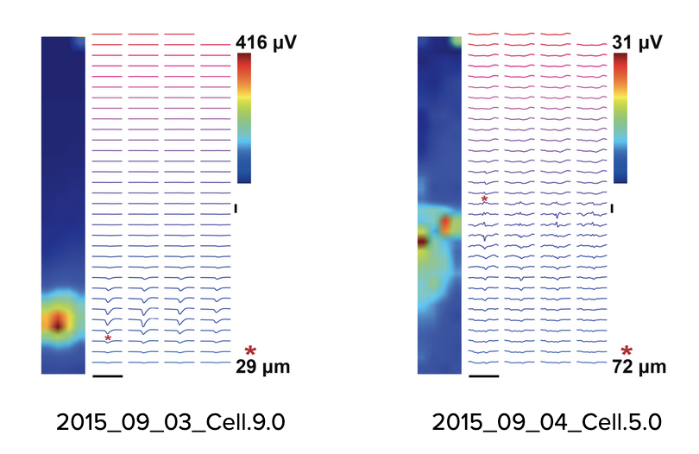
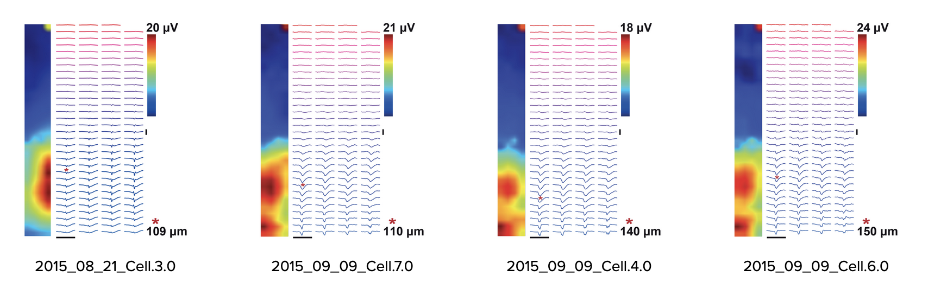
Homework
Take the script and any of Neuroseeker probes and try to solve forward problem, try to construct these maps (these have better amplitudes)

Slide 12
Popular spike sorters
Klusta (phy) — Python, obsolete, but robust
Spyking circus — Python, uses GPU
Kilosort v3 — Matlab, uses GPU, developed for NeuroPixel data (400 channels)
YASS — Python, uses GPU and Artificial Neural Networks
See also: SpikeInterface Python (https://elifesciences.org/articles/61834)
Hardcore dataset: Validating Neuropixels — https://www.biorxiv.org/content/10.1101/370080v1 https://drive.google.com/drive/folders/13GCOuWN4QMW6vQmlNIolUrxPy-4Wv1BC

